Slide 1
UBA Technology Cost Optimization
Enhancing Financial Performance through Strategic Technology Spend Reduction

Slide 2
Executive Summary
UBA, as a market leader, faces rising operational costs, particularly within technology. This proposal outlines a structured cost optimization initiative focused on technology spend, designed to reduce the cost-to-income ratio and enhance long-term value.

Slide 3
Our Methodology
1. Mobilization: Define scope, gather data, setup governance.
2. Rapid Assessment: Identify major cost drivers and inefficiencies.
3. Opportunity Validation: Deep-dive analysis and stakeholder input.
4. Implementation Planning: Build roadmap and business case.

Slide 4
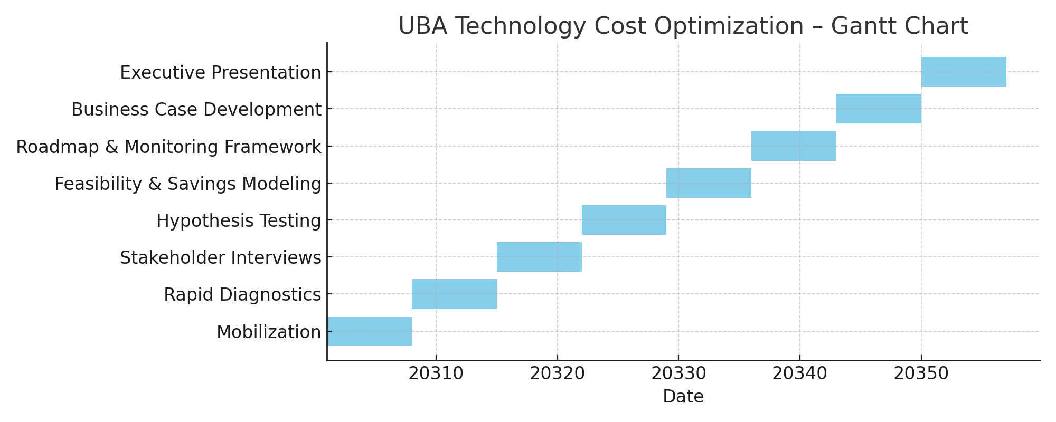
2-Month Implementation Gantt Chart
Overview of weekly project execution plan.

Slide 5
Case Studies: Proven Results
1. Nigerian Commercial Bank (via KPMG):
- 46% reduction in user licenses, 50% license cost savings.
- Consolidated ATM vendors from 4 to 2.
- Reclassified 70% of users to basic tier.
2. Global Telecom Company:
- $600M in run-rate savings over 5 years.
- 30% reduction in hardware/software maintenance.
- Rationalized 20% of application portfolio.

Slide 6
Technology Cost Optimization Levers
- License rationalization
- Vendor consolidation
- Cloud migration strategy
- Hardware refresh and decommissioning
- App rationalization
- Network optimization (SD-WAN)
- End-user computing optimization
- IT service delivery model refinement

Slide 7
Fee Proposal
• Assessment & Roadmap (2 months): Fixed competitive fee
• Implementation: Success-based billing
- 15% of verified cost savings
This model ensures alignment between value delivered and fee paid, with full transparency and outcome accountability.

